Slide 1
Probability Distributions

Slide 2
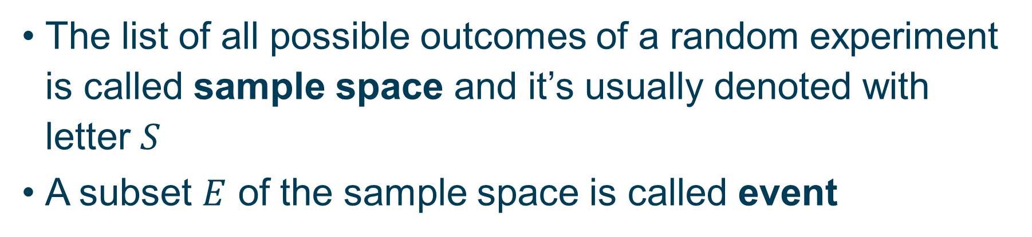
Sample Space and Events
The list of all possible outcomes of a random experiment is called sample space and it’s usually denoted with letter $S$
A subset $E$ of the sample space is called event

Slide 3
For Example
Toss a coin
Sample space $S=\left\{H,T\right\}$
Possible events $∅$ $\left\{H\right\}$ $\left\{T\right\}$ $\left\{H,T\right\}$

Slide 4
For Example
Roll a die
Sample space $S=\left\{1, 2, 3, 4, 5, 6\right\}$
Possible events $\left\{1\right\}$ $\left\{1, 2\right\}$ $\left\{1, 3, 5\right\}$ $\left\{1, 2, 3, 4, 5, 6\right\}$

Slide 5
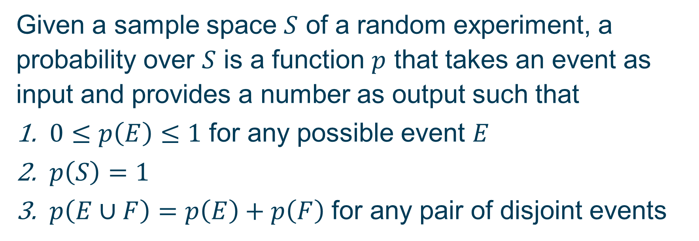
Probability
Given a sample space $S$ of a random experiment, a probability over $S$ is a function $p$ that takes an event as input and provides a number as output such that
$0≤p\left(E\right)≤1$ for any possible event $E$
$p\left(S\right)=1$
$p\left(E∪F\right)=p\left(E\right)+p\left(F\right)$ for any pair of disjoint events

Slide 6
For Example
Toss a fair coin
Sample space $S=\left\{H,T\right\}$
Probability $p\left(H\right)=p\left(T\right)=0.5$

Slide 7
For Example
Roll a fair die
Sample space $S=\left\{1, 2, 3, 4, 5, 6\right\}$
Probability $p\left(i\right)=1/6$ for $i=1, …, 6$

Slide 8
For Example
Toss a biased coin
Sample space $S=\left\{H,T\right\}$
Probability $p\left(H\right)=0.3$ $p\left(T\right)=0.7$

Slide 9
For Example
Roll a biased die
Sample space $S=\left\{1, 2, 3, 4, 5, 6\right\}$
Probability $p\left(1\right)=0.3$ $p\left(i\right)=0.14$ for $i=2, …, 6$

Slide 10
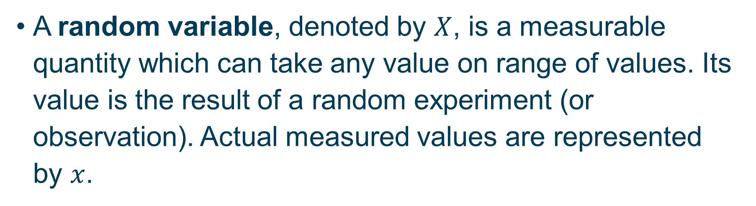
Random Variable
A random variable, denoted by $X$, is a measurable quantity which can take any value on range of values. Its value is the result of a random experiment (or observation). Actual measured values are represented by $x$.

Slide 11
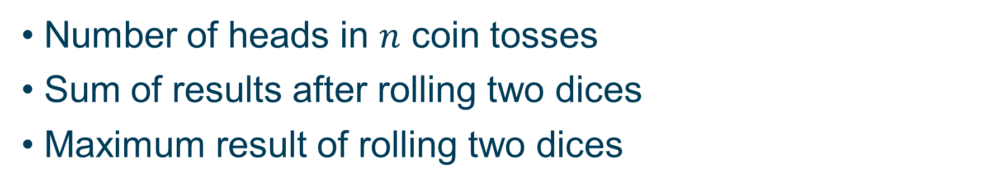
For Example
Number of heads in $n$ coin tosses
Sum of results after rolling two dices
Maximum result of rolling two dices

Slide 12
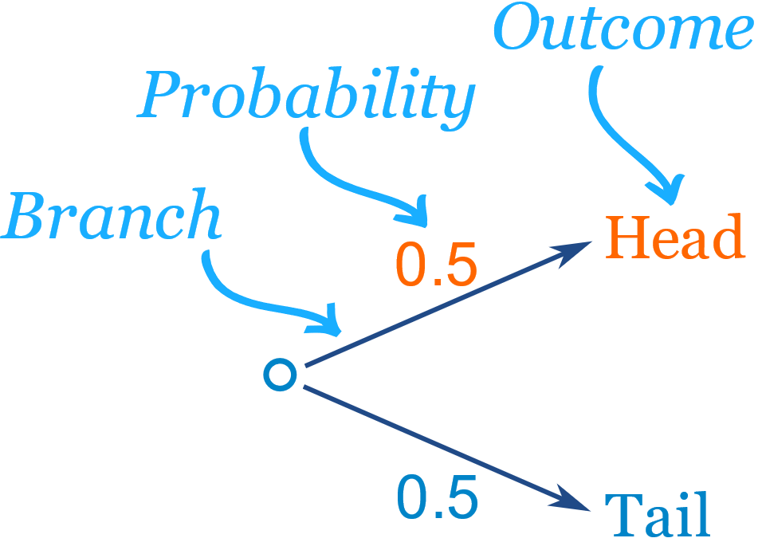
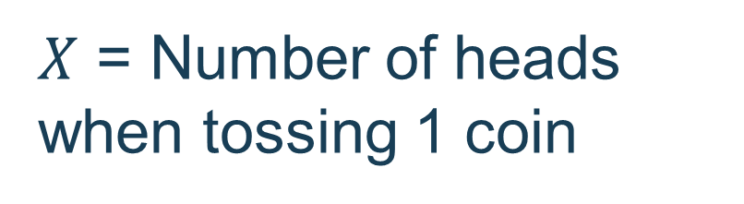
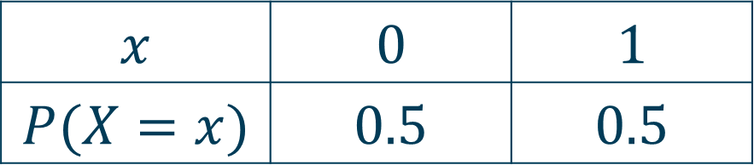
For Example
$X$ = Number of heads when tossing 1 coin
$$x$$ | $$0$$ | $$1$$
$$P(X=x)$$ | $$0.5$$ | $$0.5$$

Slide 13
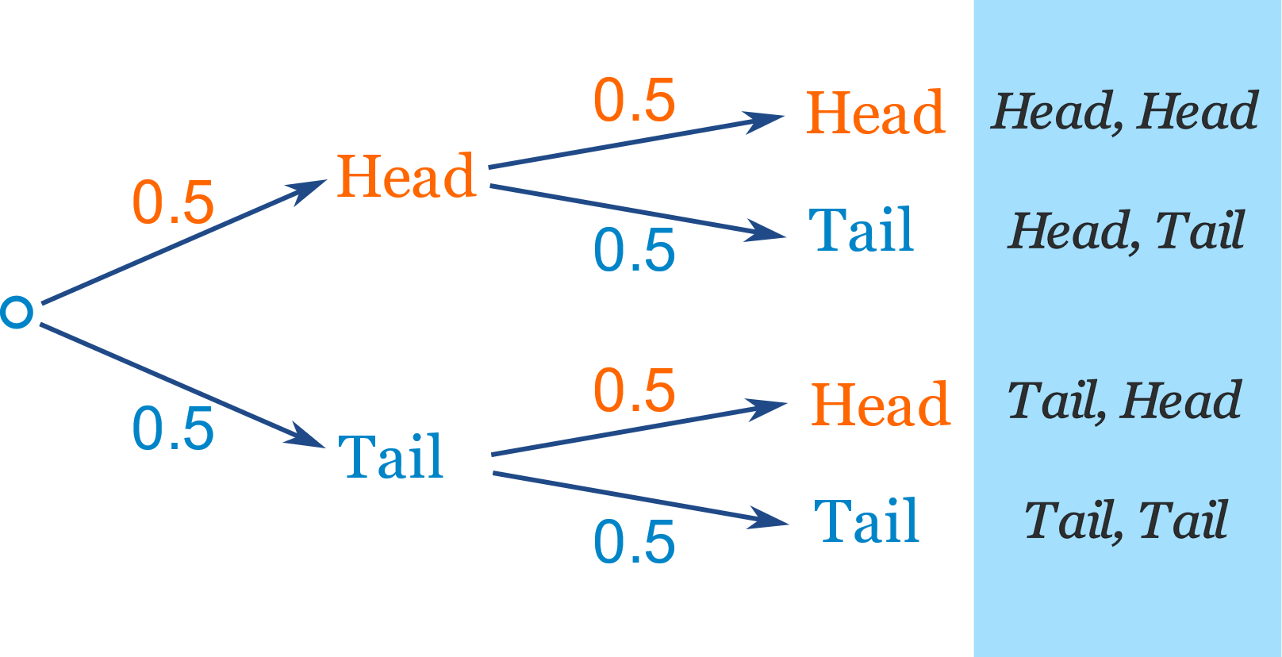
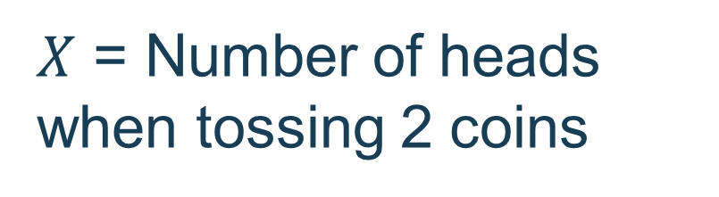
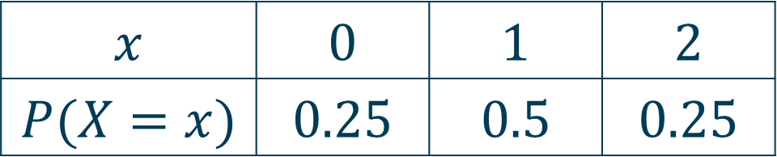
For Example
$X$ = Number of heads when tossing 2 coins
$$x$$ | $$0$$ | $$1$$ | $$2$$
$$P(X=x)$$ | $$0.25$$ | $$0.5$$ | $$0.25$$

Slide 14
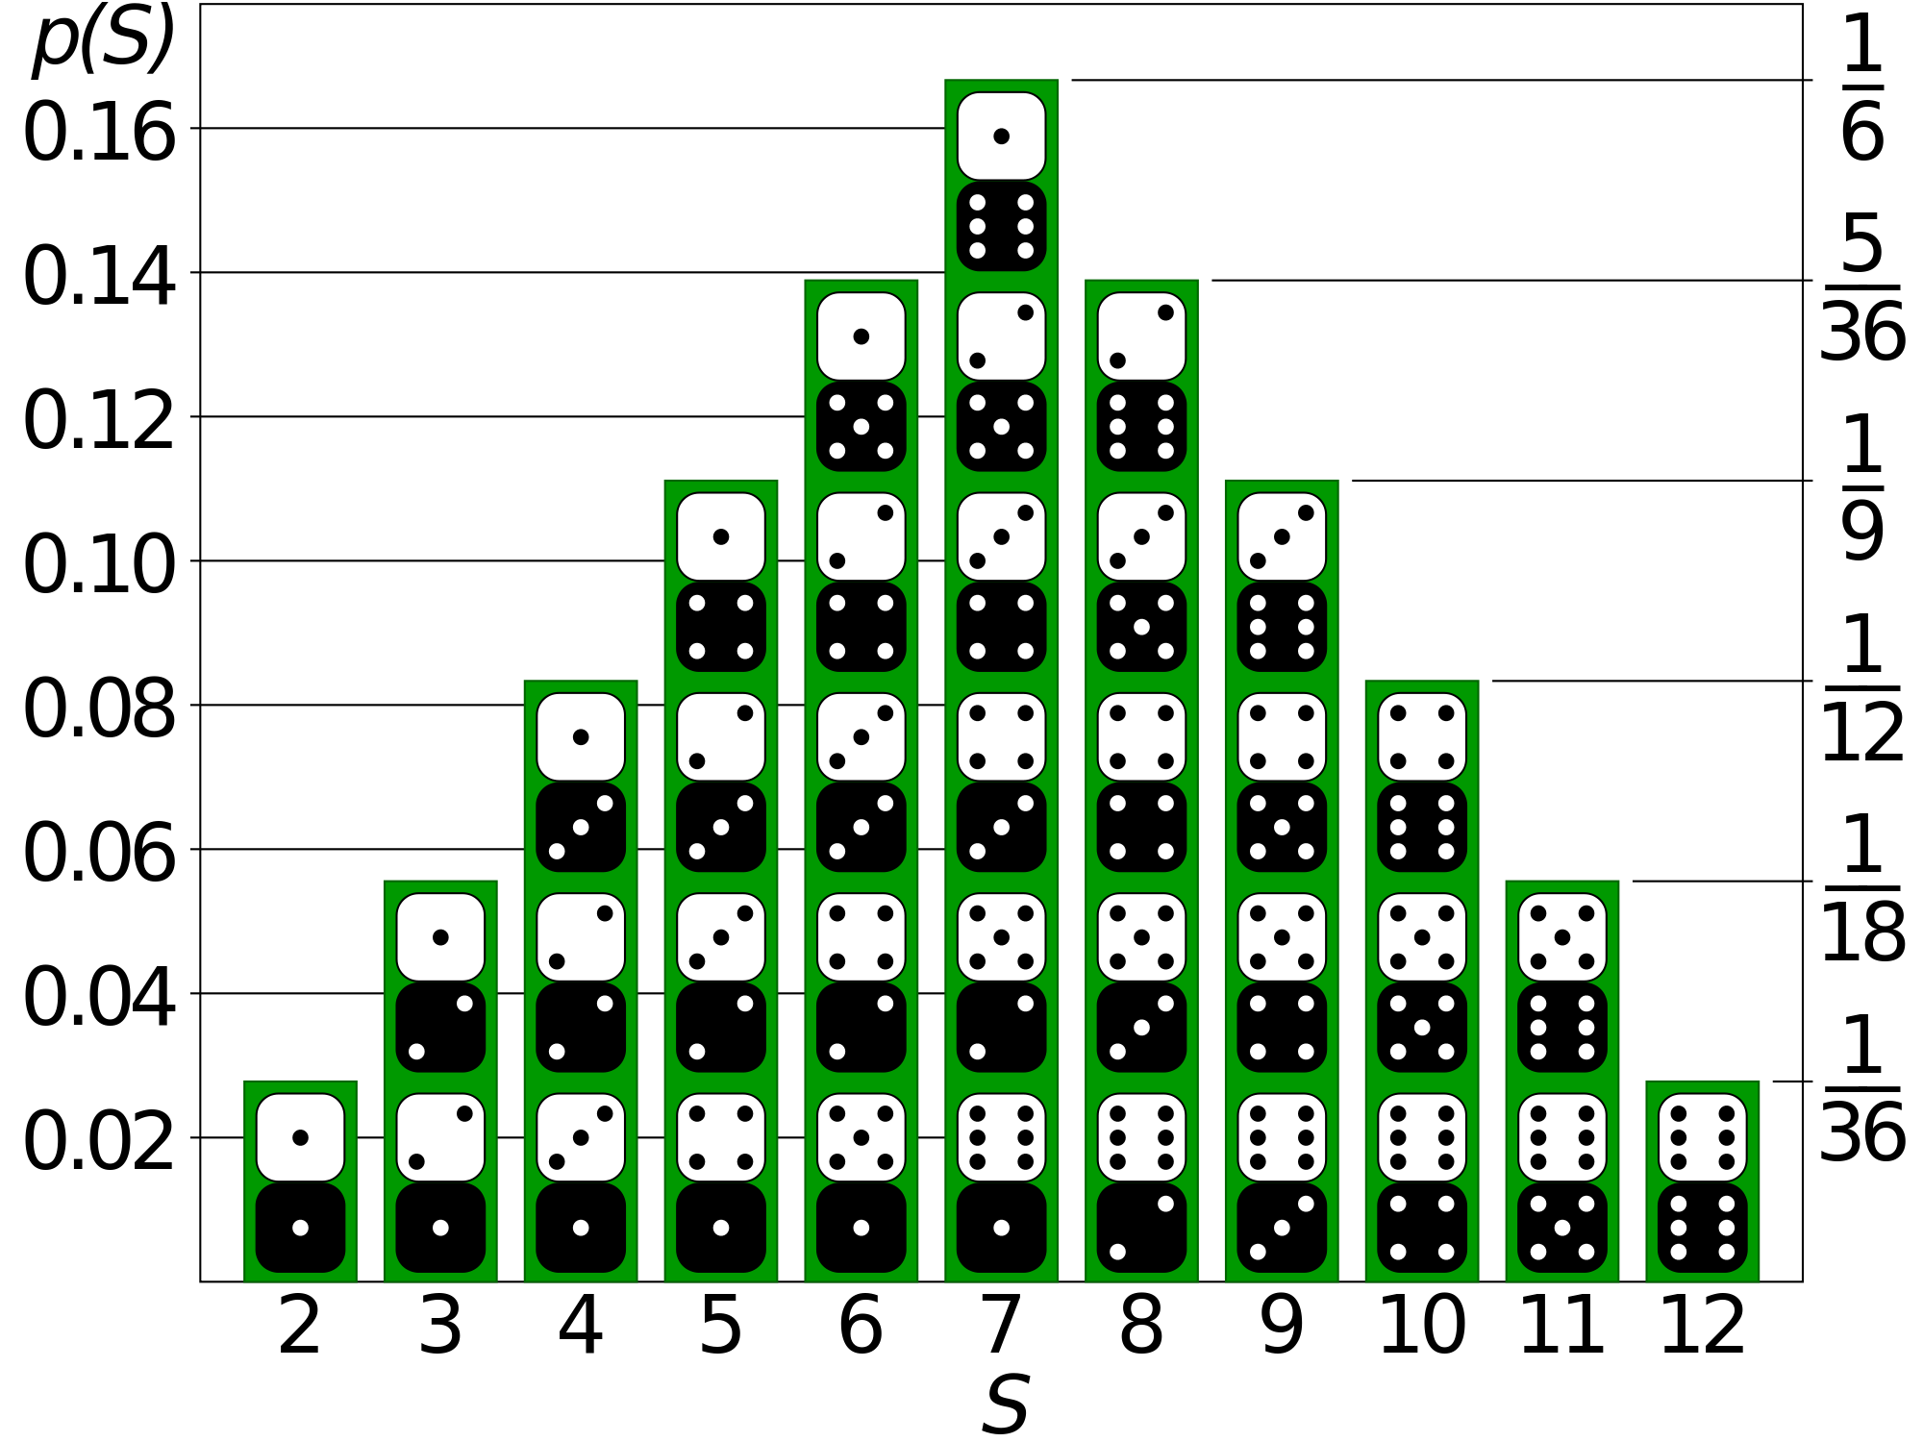
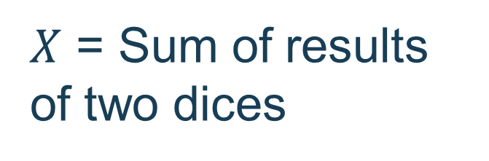
For Example
$X$ = Sum of results of two dices

Slide 15
Bernoulli Distribution
Binary outcome
Sample space $S=\left\{0, 1\right\}$
Probability $p\left(1\right)=p$ $p\left(0\right)=1−p$

Slide 16
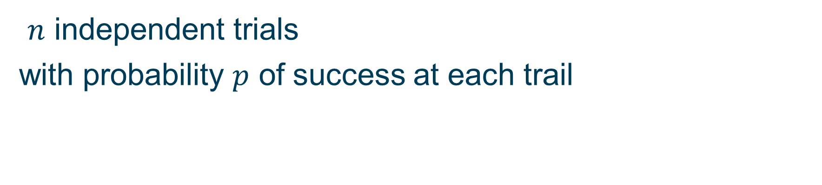
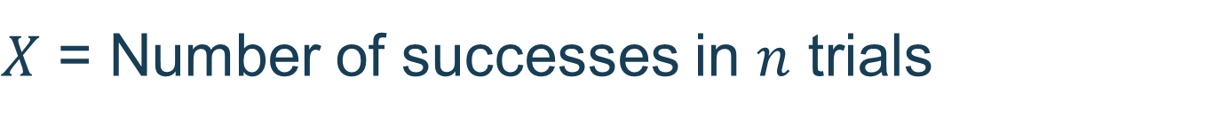
Binomial Distribution
$n$ independent trials
with probability $p$ of success at each trail
$X$ = Number of successes in $n$ trials
Probability distribution $P\left(X=k\right)=\left(\begin{matrix}n \\ k\end{matrix}\right)p^{k}{\left(1−p\right)}^{n−k}$

Slide 17
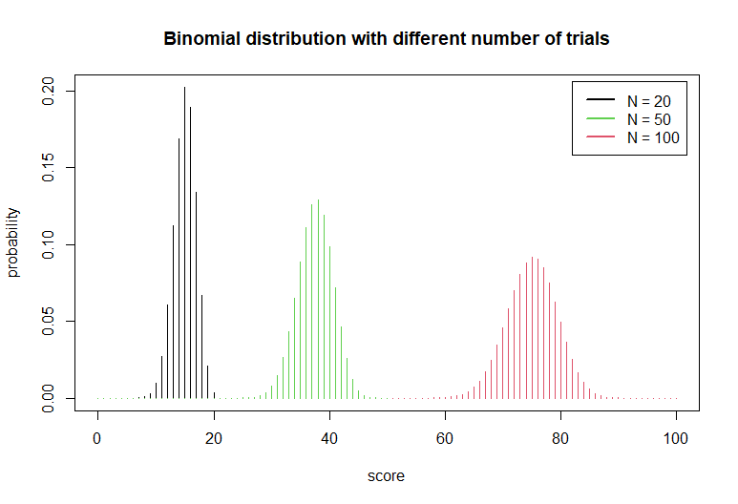

Slide 18
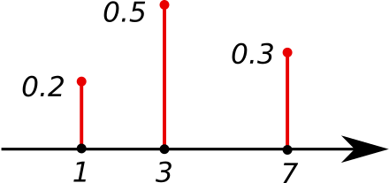
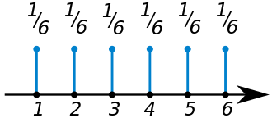
Discrete Random Variables
So far, we talked about discrete random variables, variables that can take on only a countable number of values
The distribution of a discrete random variable is also called probability mass function

Slide 19
Continuous Random Variables
Continuous random variables can take values in a (possibly unbounded) interval of numbers
The distribution of a continuous random variable is also called probability density function

Slide 20
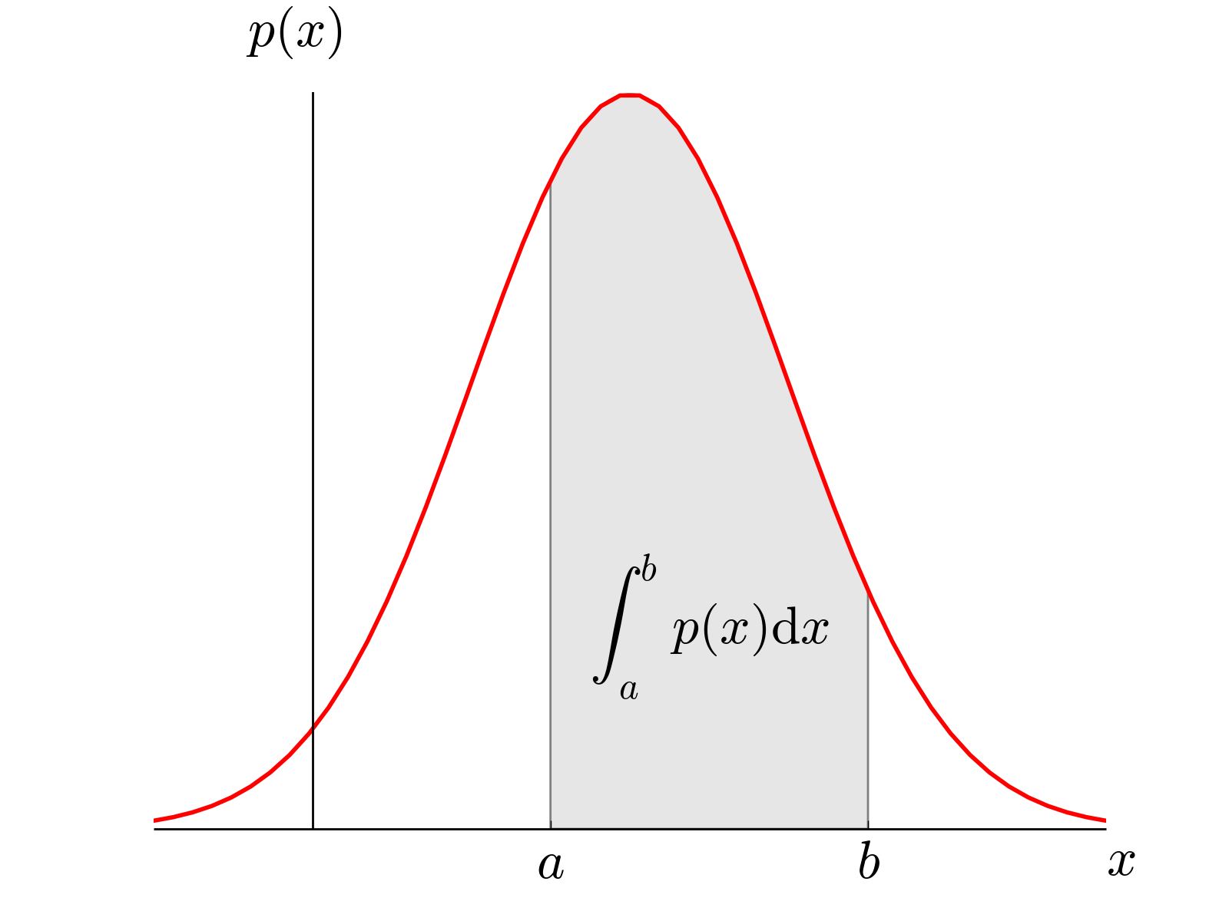

Slide 21
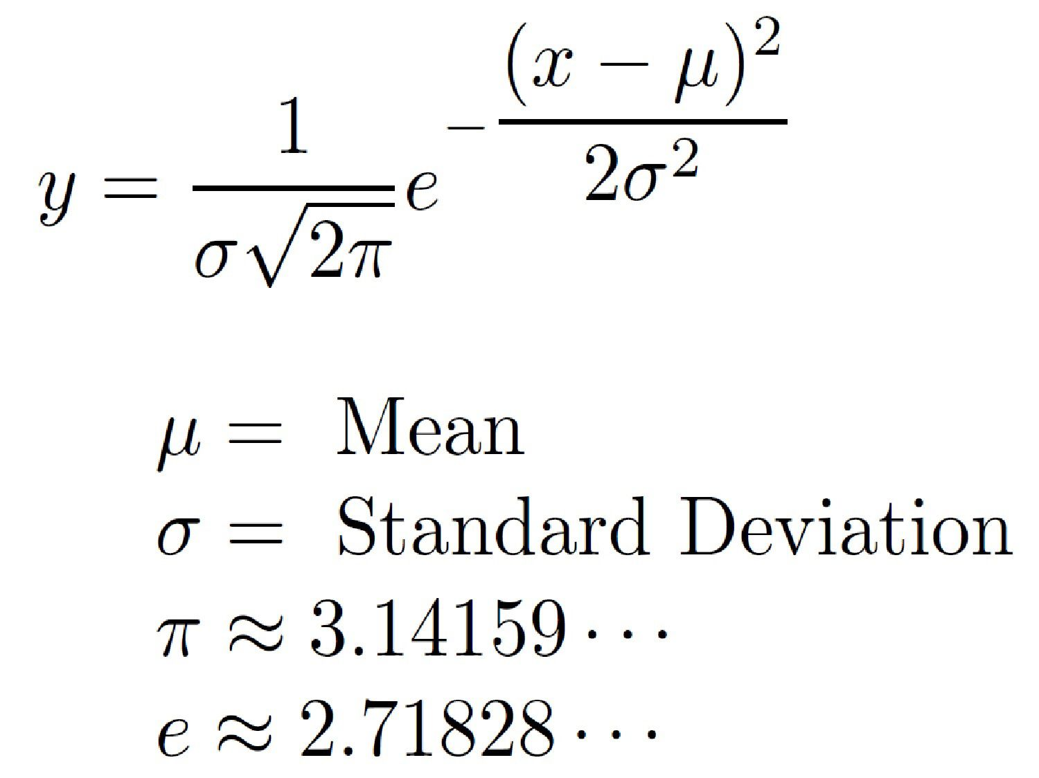
Normal Distribution

Slide 22
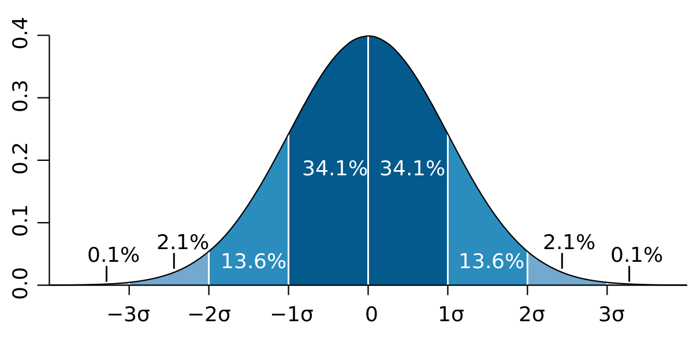
Normal Distribution

Slide 23
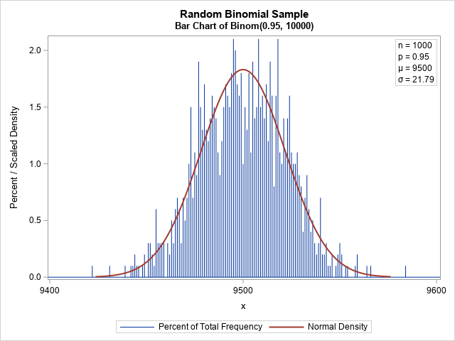

Slide 24
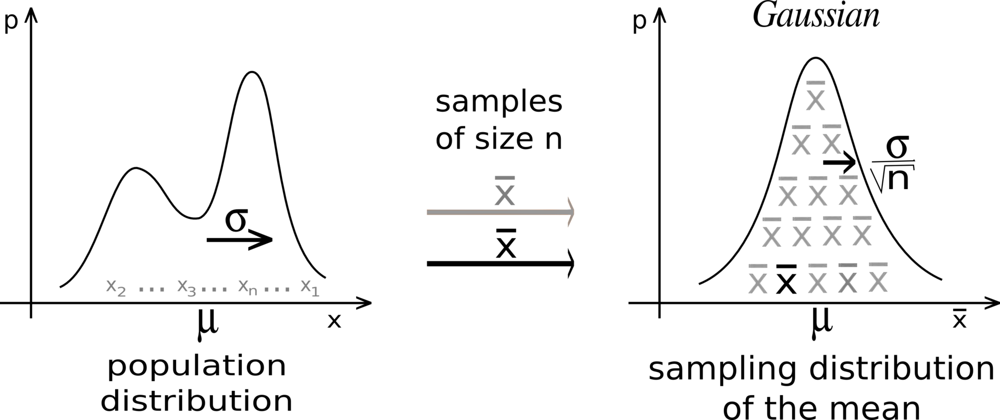
Why Normal Distribution is Important?

Slide 25
Independent study
R read chapter 1 of statistics in R course (learning hub)
Python read chapter 3 of statistics in Python course (learning hub)
Additional references
Statistical distributions with practical examples https://datasciencedojo.com/blog/types-of-statistical-distributions-in-ml/
If you want to dig into mathematical details a free (full!) course in probability https://online.stat.psu.edu/statprogram/stat414

Slide 26
Additional references
R probability distributions https://rstudio.github.io/r-manuals/r-intro/Probability-distributions.html
Python stats models distributions https://www.statsmodels.org/stable/distributions.html

